Slide 1
Prototype for Automated Playlist Generation
for MOOSIC
Developed and presented by:
Kwabena Agyei Benno Klan Oleksandra Tkachenko

Slide 2
Challenge We Faced & Goal We Pursue
Manual playlists curation does not scale due to:
requires expert time
hard to maintain consistency
difficult to scale to thousands of songs
Our Goal:
Determine if machine learning can automatically group similar songs into playlists.

Slide 3
How We Built the Prototype
Collect Data: Dataset of 5000 Spotify songs
Select the Most Relevant Features ('danceability', 'energy', 'loudness', 'speechiness', 'acousticness', 'instrumentalness', 'liveness', 'valence', 'tempo')
Prepare the Data for Comparison (scale data)
Group Similar Songs (using machine learning method K-Means)
Create Playlists from the Groups

Slide 4
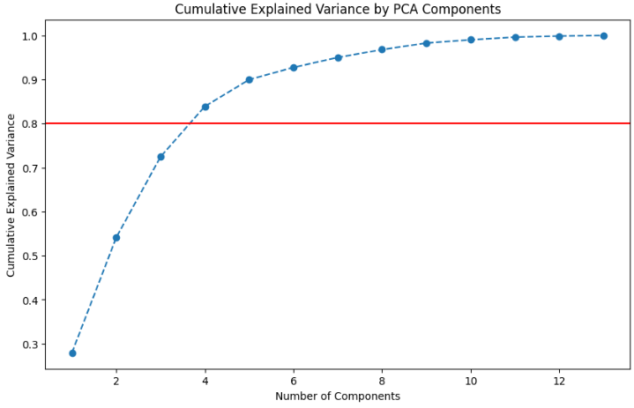
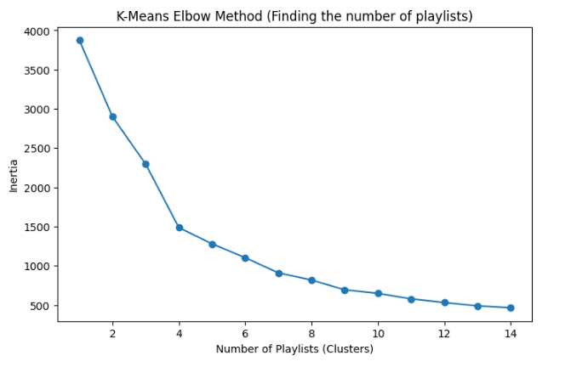
Building the playlist prototype based on our algorithms
Conversion of 13 features into 4
Mathematical scan identifies 9 musical profiles

Slide 5

Refining our music model: 9 vs 50 playlists
Playlist ID Number of songs
1 378
2 650
3 536
4 603
5 304
6 349
7 596
8 901
9 918
AVG 582
Playlist ID Number of songs
1 93
2 89
3 159
4 98
5 124
6 116
7 114
8 82
9 121
AVG 105
While our model yields massive playlists, refining it enables curated playlists

Slide 6
Are Spotify’s audio features capable of identifying “similar songs” as defined by humanly detectable criteria?
Partially yes – songs that cluster together in features like danceability, energy, valence, tempo, acousticness often sound similar in mood or vibe.
Example: A cluster of songs with low danceability and energy tend to be slower, calmer tracks.
Caveat: There are outliers – two songs can have almost identical features but feel very different to human listeners.
Technical note: Scaling these features (all Features between 0–1) ensures each feature contributes equally to similarity calculations.

Slide 7
Is K-Means a good method for creating playlists?
Pros (Advantages):
automatic playlist creation
helps identify unusual songs
organizes large music collections
Cons (Disadvantages):
choosing the number of playlists (methods like the elbow or silhouette score can help)
results may vary slightly
music is more complex than the model assumes
sensitive to unusual songs

Slide 8
Conclusion
Machine learning can scale playlist creation.
The prototype shows songs can be grouped by sound similarity.
However:
we would strongly recommend an approach that combines not only analysis of audio features but also user behaviour data.

Slide 9
Questions

Slide 10
Pros and cons of spotify’s audio features
Pros of using Spotify audio features: Quantifiable and consistent across songs Easy to cluster/group songs computationally Covers measurable aspects of mood, tempo, energy | Cons: Ignores lyrics, themes, and cultural context Can miss subtle human perceptions of similarity Some songs may appear similar in data but sound different to human listeners

Slide 11
Next Steps
Our prototype groups songs only using audio features.
However, this does not fully reflect how listeners perceive song similarity.
To improve playlist relevance, we could add:
user behavior data (likes, skips, listening history)
lyrics and semantic information (song themes, mood)
contextual metadata (genre, artist relationships, release year)
human curation insights (expert knowledge about music styles)
additional machine learning methods (Hierarchical clustering, DBSCAN, Recommendation systems)

